Slide 1
Data Science
General Assembly Lecture 2
Instructor: Hamed Hasheminia

Slide 2
Learning Objectives (Cont. Lecture 1)
Supervised – Unsupervised learning
Classification vs Regression
Flexibility vs Interpretability

Slide 3
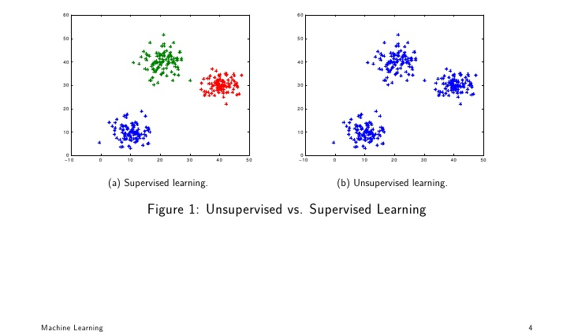
Supervised vs Unsupervised Learning

Slide 4
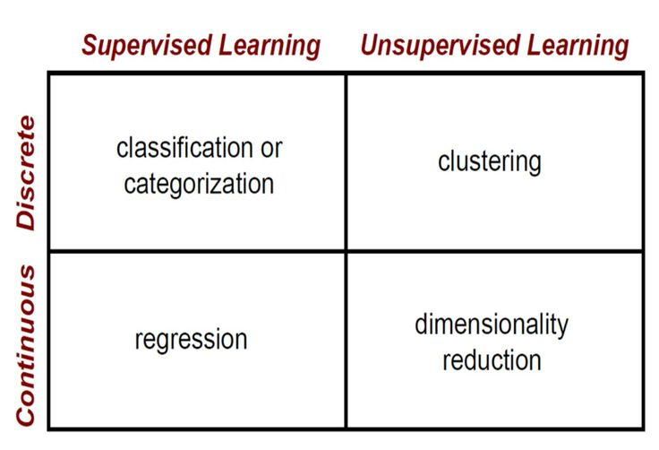
Supervised vs Unsupervised Learning

Slide 5
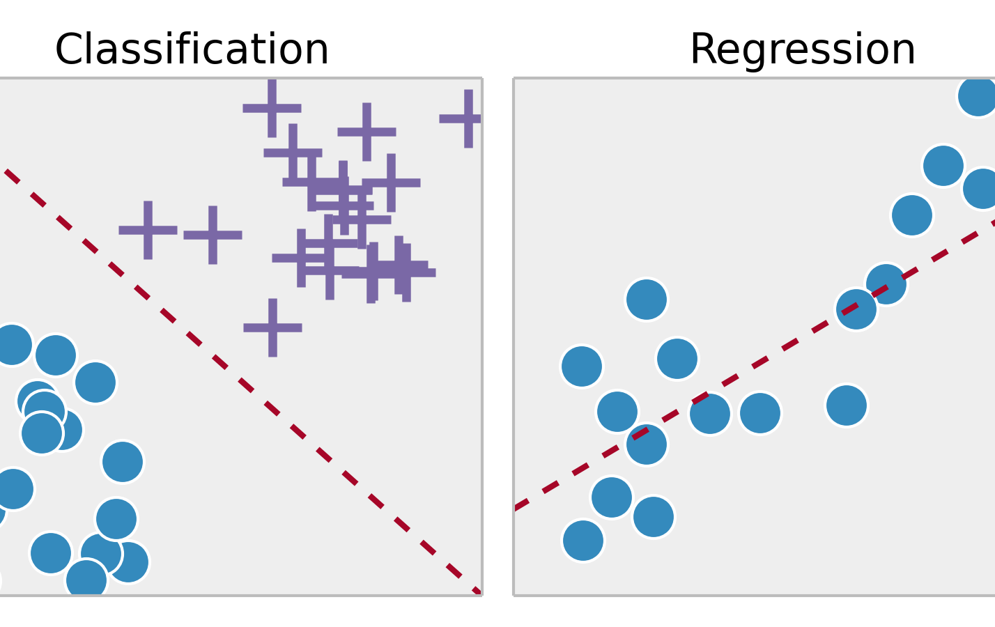
Supervised Learning – Classification vs Regression

Slide 6
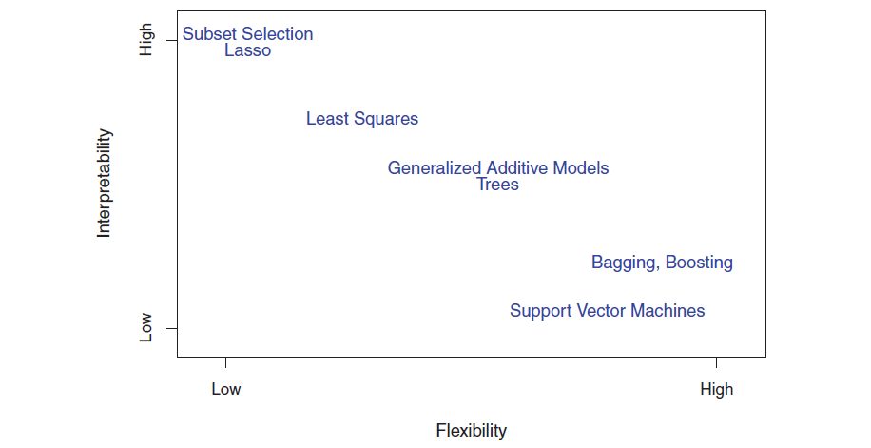
Flexibility vs Interpretability

Slide 7
Learning Objectives (Lecture 2)
Define a problem and types of data
Identify data set types
Apply the data science workflow in the pandas context
Create an iPython Notebook to import, format, and clean using the Pandas library

Slide 8
Why data types matter?
Different data types have different limitations and strengths.
Certain types of analyses aren’t possible with certain data types.
There are 3 types of data which we may might use for analysis:
1. Time series data: Time-Series data are data on one variable collected at a single point in time, e.g.
2. Cross-sectional data: Cross-sectional data are data on one or more variables collected at a single point in time, e.g.
3. Panel data, a combination of 1. & 2.

Slide 9
Cross-Section or Time Series?
You would like to find the the relationship between company size and the return to investing in its shares. You survey different company sizes and their corresponding returns. What type of data did you collect?
You would like to discover how the value of Apple’s stock price has varied when it announced the value of its dividend payment. What type of data will you collect to answer this question?

Slide 10
WALKTHROUGH ACQUIRE & PARSES WITH PANDAS

Slide 11
Acquire
Where we determine if we have the “right” dataset for our problem
Questions to ask:
What type of data is it, cross-sectional or longitudinal?
How well was the data collected?
Is there much missing data?
Was the data collection instrument validated and reliable?
Is the dataset aggregated?
Do we need pre-aggregated data?

Slide 12
LOGISTICS OF ACQUIRING YOUR DATA
Data can be acquired through a variety of sources
Web (Google Analytics, HTML, XML)
File (CSV, XML, TXT, JSON
Today, we’ll use a try Web, CVS, and HTML!

Slide 13
PARSE: UNDERSTANDING YOUR DATA
You need to understand what you’re working with.
To better understand your data
Create or review the data dictionary
Perform exploratory surface analysis
Describe data structure and information being collected
Explore variables and data types

Slide 14
INTRO TO DATA DICTIONARIES AND DOCUMENTATION
Data dictionaries help judge the quality of the data.
They also help understand how it’s coded.
Does gender = 1 mean female or male?
Is the currency dollars or euros?
Data dictionaries help identify any requirements, assumptions, and constraints of the data.
They make it easier to share data.

Slide 15
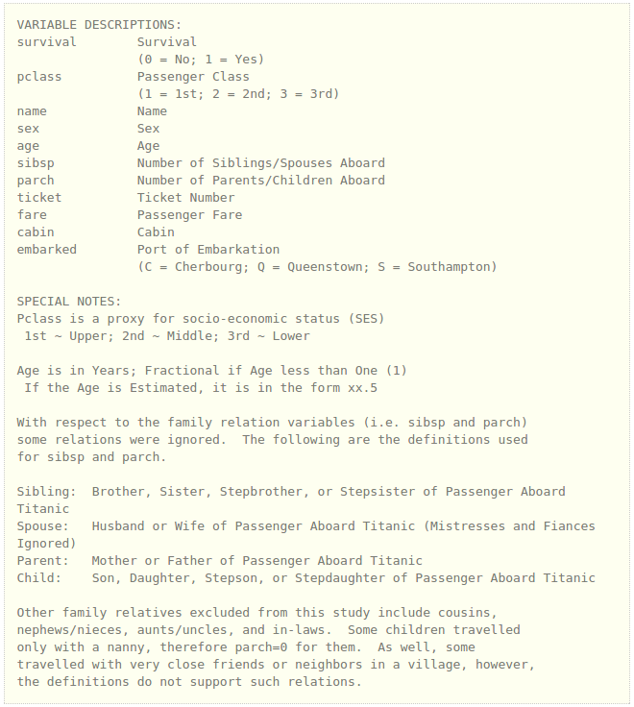
DATA DICTIONARY EXAMPLE: KAGGLE TITANIC DATA

Slide 16
NUMPY AND PANDAS INTRO

Slide 17
NUMPY AND PANDAS INTRO
What are Numpy and Pandas? Python packages
Pands is built on Numpy.
Numpy uses arrays to do basic math and slice and index data.
Pandas uses a data structure called a Dataframe.
Dataframes are similar to Excel tables; they contain rows and columns.
Notes:
- note that this methodology is probably the most standardized but is falling out of fashion, especially with smaller companies

Slide 18
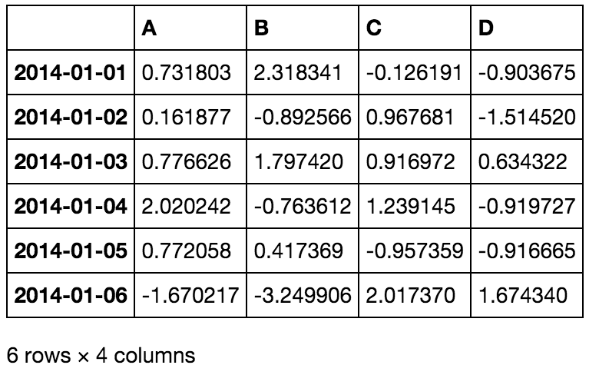
NUMPY AND PANDAS INTRO
Notes:
- note that this methodology is probably the most standardized but is falling out of fashion, especially with smaller companies

Slide 19
NUMPY AND PANDAS INTRO
With these packages, you can select pieces of data, do basic operations, calculate summary statistics.
Follow along and code along as we learn about Numpy and Pandas.
Notes:
- note that this methodology is probably the most standardized but is falling out of fashion, especially with smaller companies

Slide 20
NUMPY AND PANDAS INTRO
We often have to validate data, correct missing data, and plot our findings.
Once again, follow and code along.
Notes:
- note that this methodology is probably the most standardized but is falling out of fashion, especially with smaller companies

